Slide 1
ROLES OF A SCRUM-AGILE TEAM
Scrum Master
Responsible for ensuring that scrum is understood and enacted
Servant-leader
Helps those outside of the team understand their interactions with the team
Helps maximize the value created by the scrum team
Finds ways to manage the product backlog
Understands and practices agile practices
Facilitates scrum events
Removes roadblocks to the team's progress

Slide 2
ROLES OF A SCRUM-AGILE TEAM
Product Owner
Responsible for maximizing the value of the product and the work of the development team
The only one to manage the product backlog
Ensures the product backlog is visible, transparent, and clear to all
Makes sure the development team understands the items on the product backlog
Represents the business sponsors
The decision maker for the project

Slide 3
ROLES OF A SCRUM-AGILE TEAM
Developer
Professionals who do the work of delivering “potentially released increments of a done Product”
Structured and empowered to manage themselves
Self-organizing
Cross-functional
No titles or sub-teams
Expected to work together as a single team

Slide 4
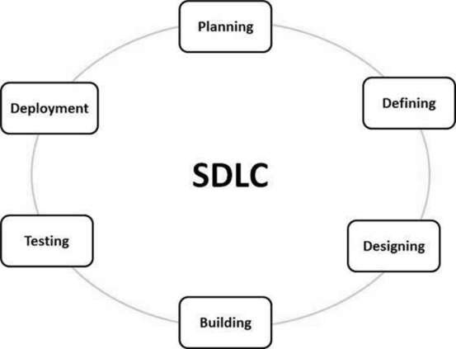
SDLC PHASES IN AN AGILE APPROACH

Slide 5
SDLC PHASES IN AN AGILE APPROACH
Planning
Time to plan the requirements and a basic plan approach
Get the input from customers, sales department, market surveys, and experts in the industry
Defining
Clearly define and document the requirements
Get approval of customer or market analysts

Slide 6
SDLC PHASES IN AN AGILE APPROACH
Designing
Defines the architectural modules of the product
Internal design should be clearly defined
Building
Actual development and production is undertaken
If the design is planned and designed well, the building of the product should be fairly hassle free

Slide 7
SDLC PHASES IN AN AGILE APPROACH
Testing
Testing is integrated through out all the stages
This stage should have a heavier lean on testing
Deployment
Once tested and ready, the product should be release to an appropriate market
May be partially released until feedback is given
This is also when maintenance and updates begins

Slide 8

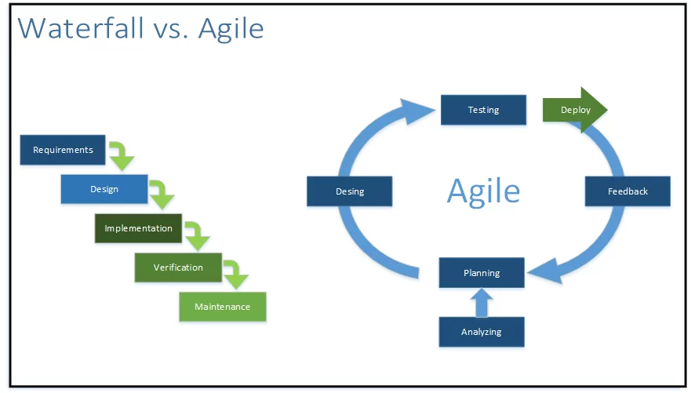
DIFFERENCES BETWEEN WATERFALL AND AGILE

Slide 9
DIFFERENCES BETWEEN WATERFALL AND AGILE
Waterfall
Classic approach
Linear
Sequential
Distinct goals for each phase
No turning back
Plan-driven
Agile
Modern approach
Small teams working intensively and interdependent
Real time decision making
Adaptive
Done in sprints

Slide 10
FACTORS WHEN CHOOSING AN APPROACH
When choosing an approach, one must consider if the project is small or large, long term or short term, does the client want to be involved or hands off?
For a client that wants to be hands on or if the project is small or has a quick turn around, then it would be better to go with and Agile approach.
Were as if the client was mostly hands-off or if the project was very complex or long running, then a waterfall approach may be best.
There is also a third option that will be most likely to be used. That is a hybrid of the two approaches. Most projects will need elements from waterfall and agile.

Slide 11
References:
“SDLC - Overview.” Tutorialspoint, www.tutorialspoint.com/sdlc/sdlc_overview.htm
Charles G. Cobb. The Project Manager’s Guide to Mastering Agile : Principles and Practices for an Adaptive Approach. Wiley; 2015. Accessed February 20, 2021. https://search-ebscohost-com.ezproxy.snhu.edu/login.aspx?direct=true&db=nlebk&AN=937009&site=ehost-live
Davies, Aron. “Waterfall vs Agile: Which Methodology Is Right for Your Project.” DevTeam.Space, 26 Sept. 2020, www.devteam.space/blog/waterfall-vs-agile-which-methodology-is-right-for-your-project/

